Slide 1
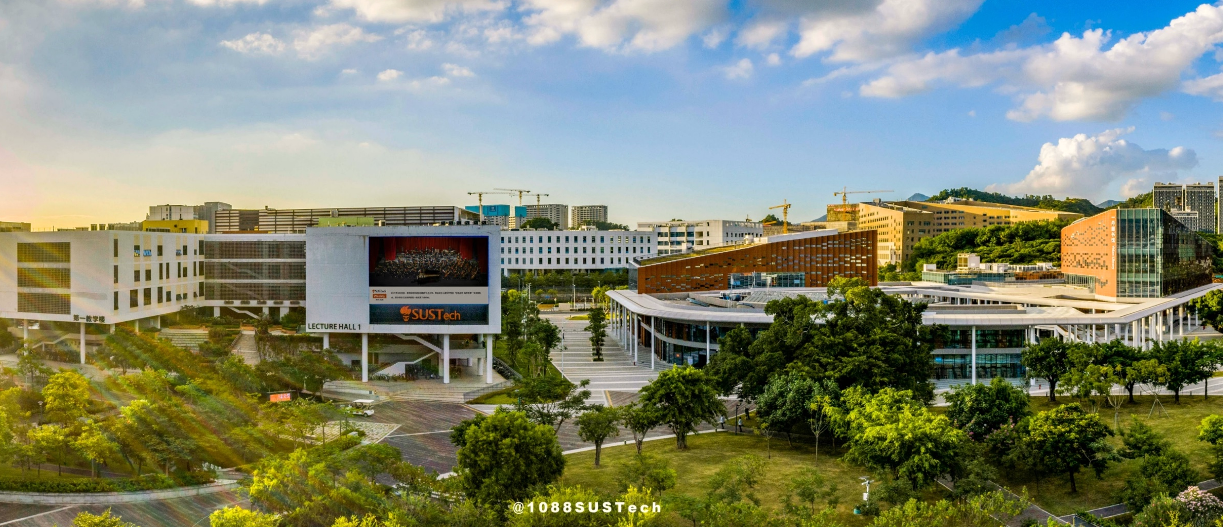

Traffic Sign and Lane Detection
组员：王雅淇、王铎磊、陈广、杨家鉴

Slide 2

Contents
目录
Traffic Sign Recognition
1
Car Distance Estimation
2
3
Lane Detection

Slide 3
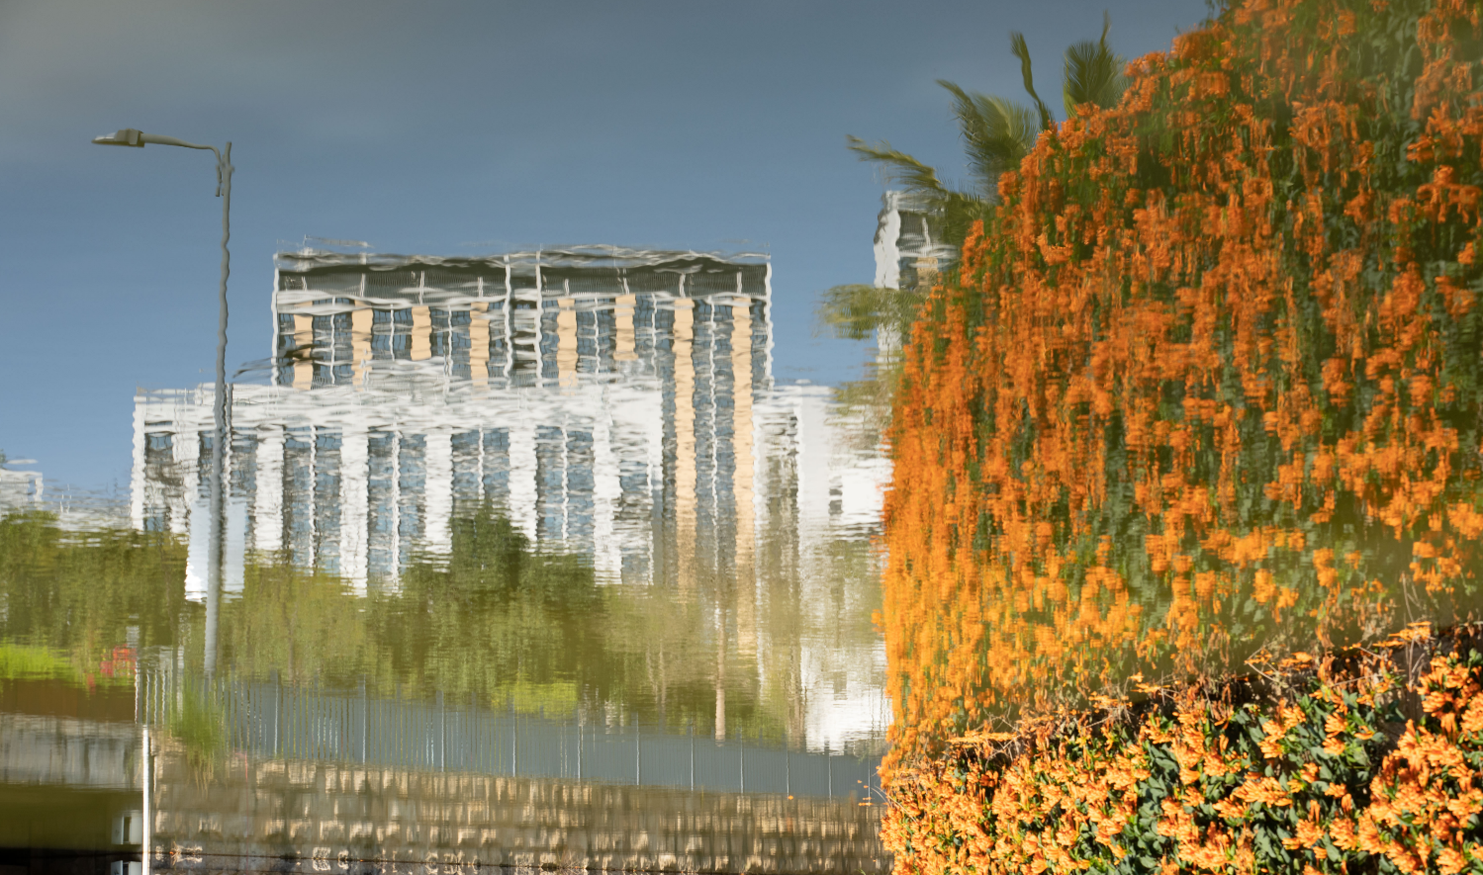
Part 01:
Traffic Sign Recognition

Slide 4
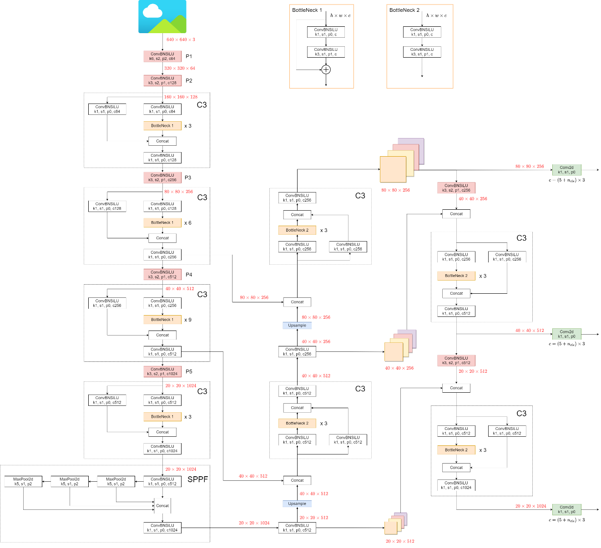
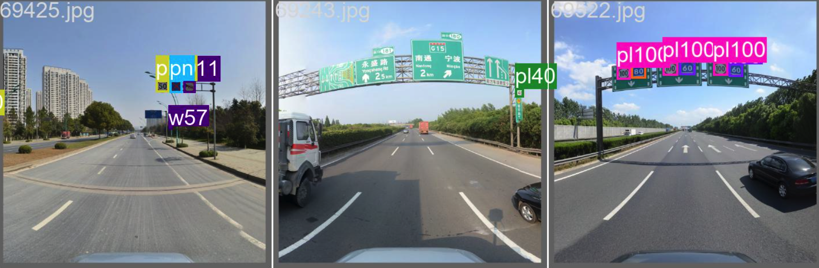
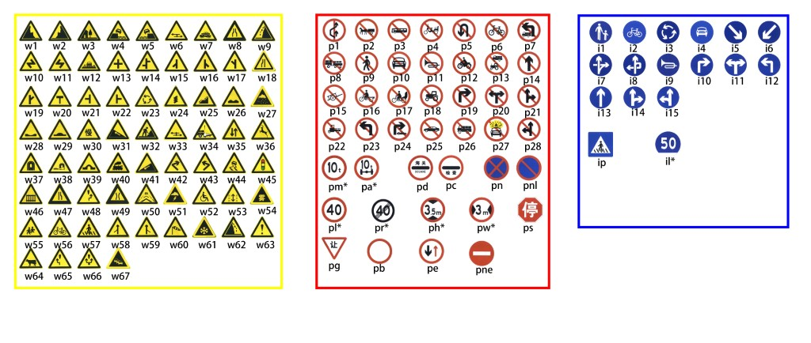
Traffic Sign Recognition
YOLOv5
TT100k

Slide 5
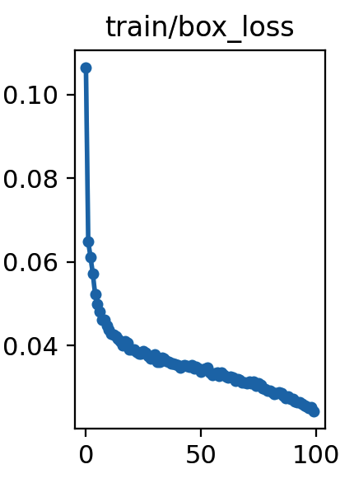
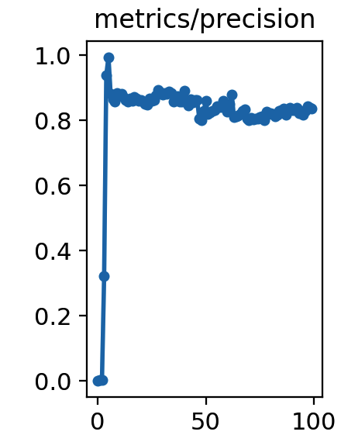
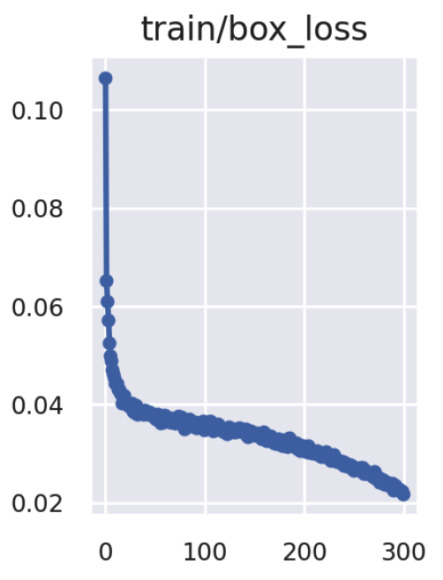
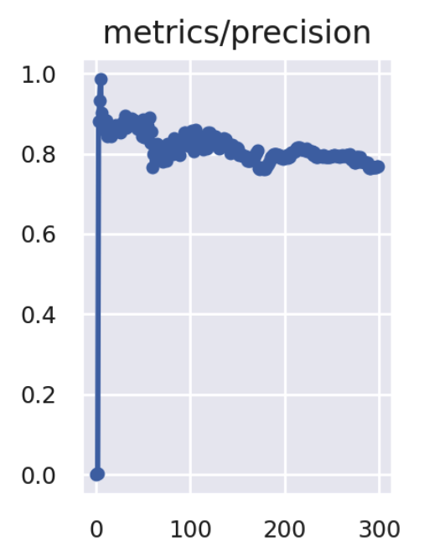
Traffic Sign Recognition
YOLOv5 + TT100k
Install CUDA and other required environment packages;
Prepare the label for training;
Train with 100 epochs and 300 epochs:
100 epochs: 7.2 h
300 epochs: 21.1 h

Slide 6
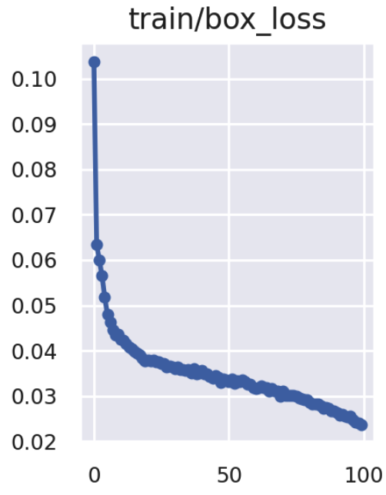
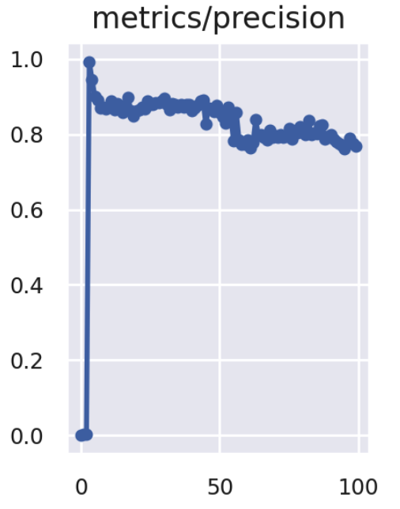
Traffic Sign Recognition
Data Augmentation
Mosic: Random number of pictures superimposed
HSV: Color gamut enhancement at pixel level
Filp up-dowm & left-right
100 epochs: 7.2 h
100 epochs without data augmentation: 7.1h

Slide 7
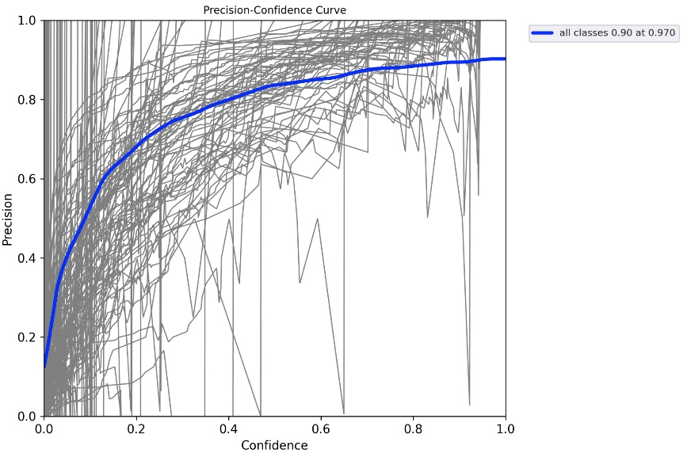
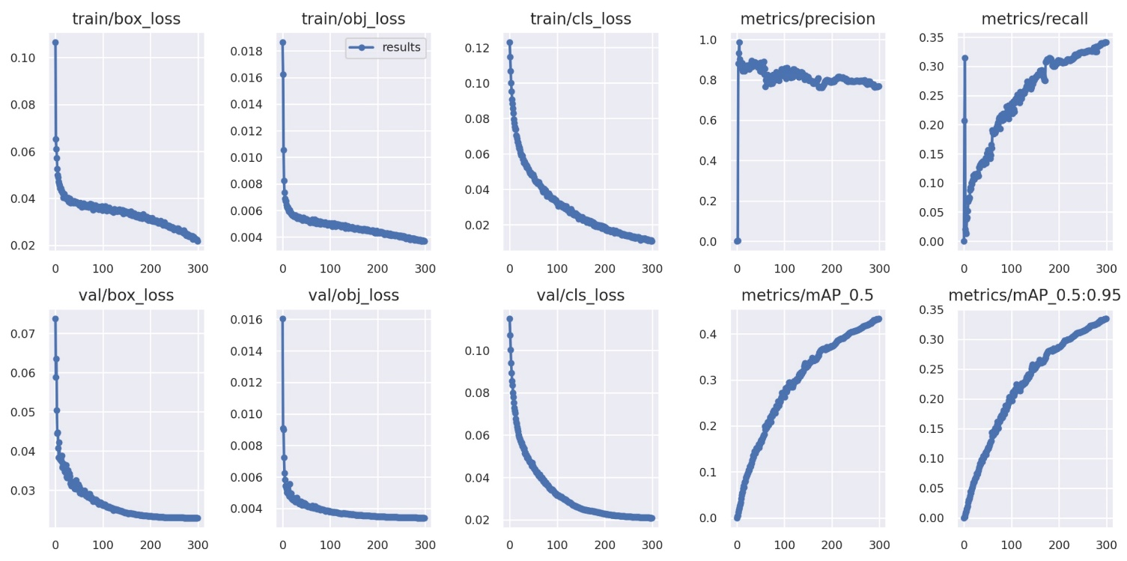
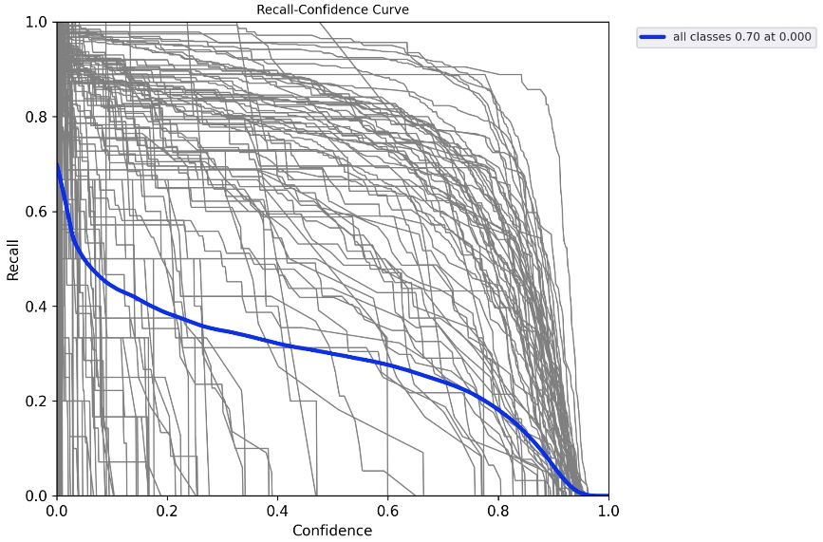
Traffic Sign Recognition
The result of 300 epochs

Slide 8
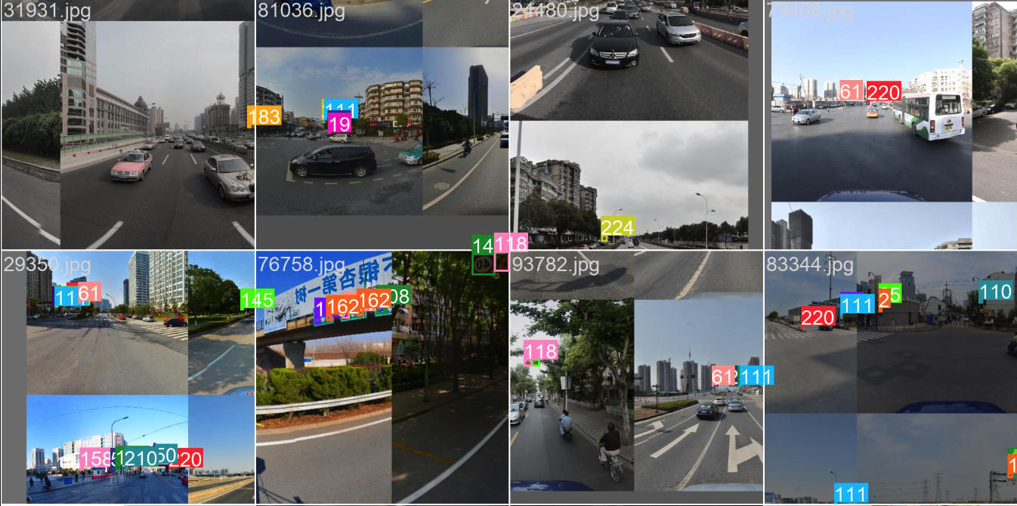
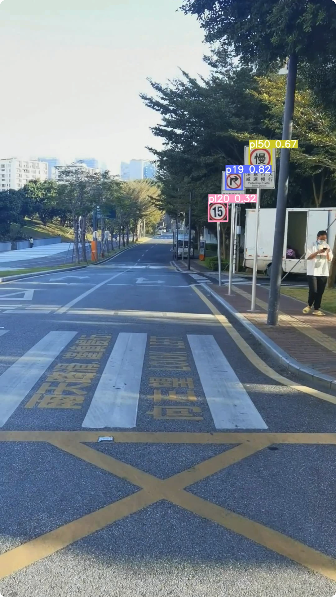
Traffic Sign Recognition
Limited by the number of training data set types, only partial flags can be recognized
Training simple with data augmentation
Test sample

Slide 9

Part 02:
Car Distance Estimation

Slide 10
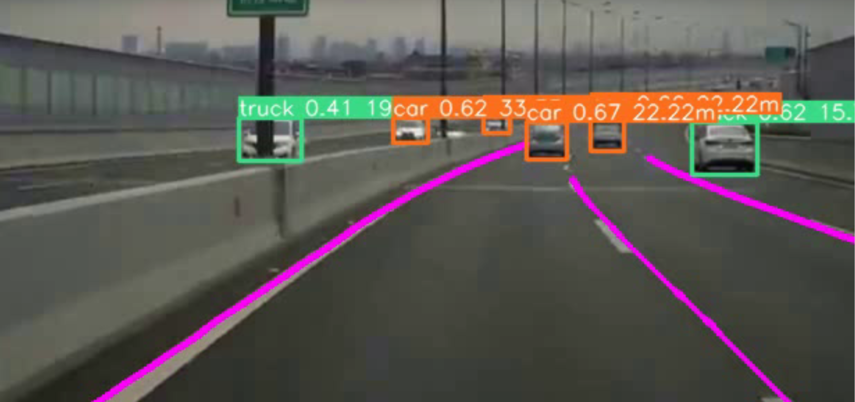
Car Distance Estimation
1. Use YOLOv5 to detect cars/trucks.
2. Given an average height of true car/truck (H) and the focal length of camera (f), we can calculate the distance with the height of frames of target (h).
H
f
Distance
h

Slide 11
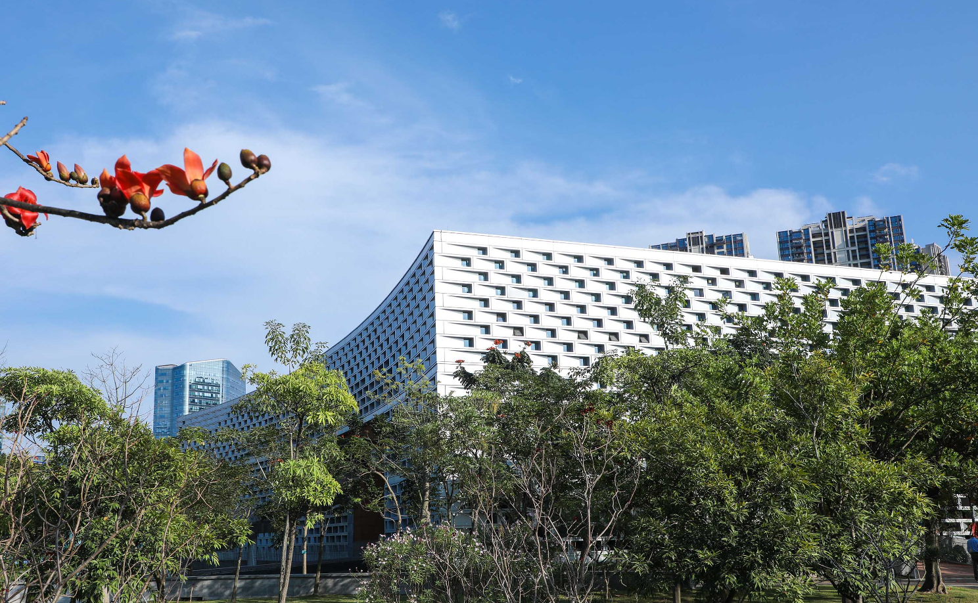
Part 03:
Lane Detection

Slide 12
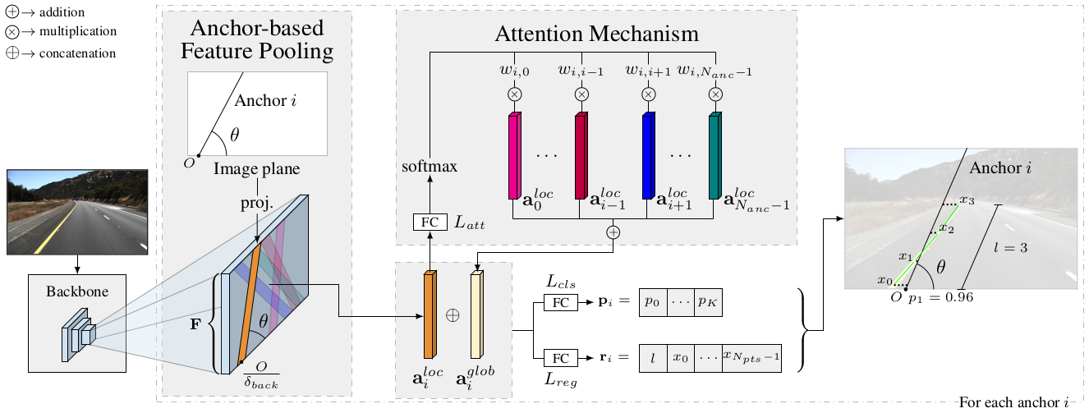
LaneATT: Real-time Attention-guided Lane Detection
detection speed: 250 FPS
Anchor based Lane Detection Attention Mechanism

Slide 13
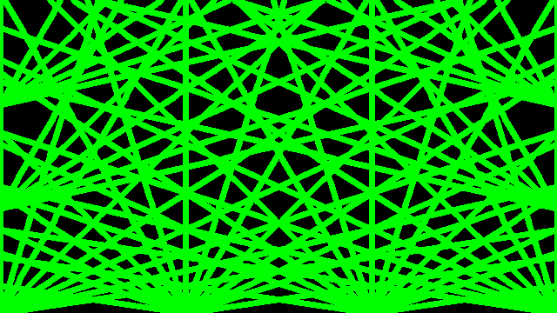
Anchors
Number of anchors: 2 * 72 * 6 + 128 * 15 = 2784
72 start points
6 angles
128 start points 15 angles

Slide 14
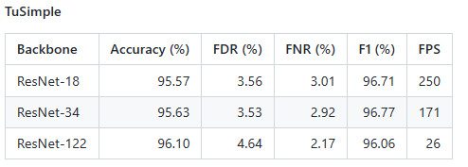
Evaluation
Training set:
3626 video clips, 20 pictures taken for 1s for each video clip
For each clip:
3626 comment frames
Test Set:
2944 video clips
Each picture: 1280 x 720

Slide 15
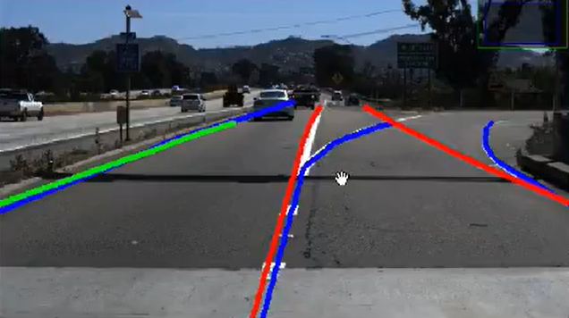
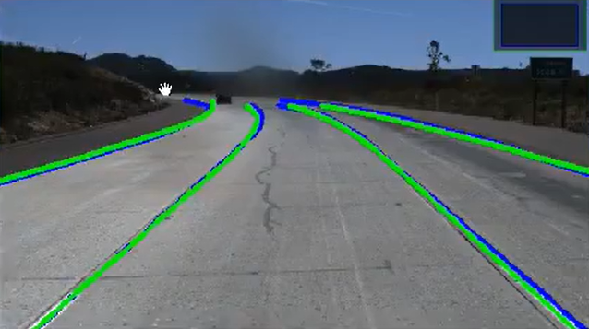
Drawbacks
Non-maximum suppression
Uniform sampling

Slide 16
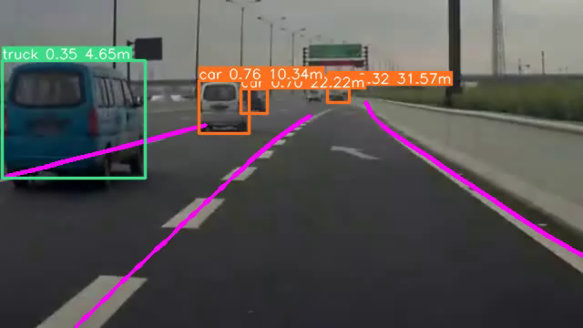
Final Result

Slide 17
References
Tabelini, L., Berriel, R., Paixao, T. M., Badue, C., De Souza, A. F., & OliveiraSantos, T. (2021). Keep your eyes on the lane: Real-time attention-guided lane detection. In Proceedings of the IEEE/CVF Conference on Computer Vision and Pattern Recognition (pp. 294-302).
https://github.com/ultralytics/yolov5
https://github.com/lucastabelini/LaneATT
https://github.com/TuSimple/tusimple-benchmark/tree/master/doc/lane_detection

Slide 18
Thank You!

